Slide 1
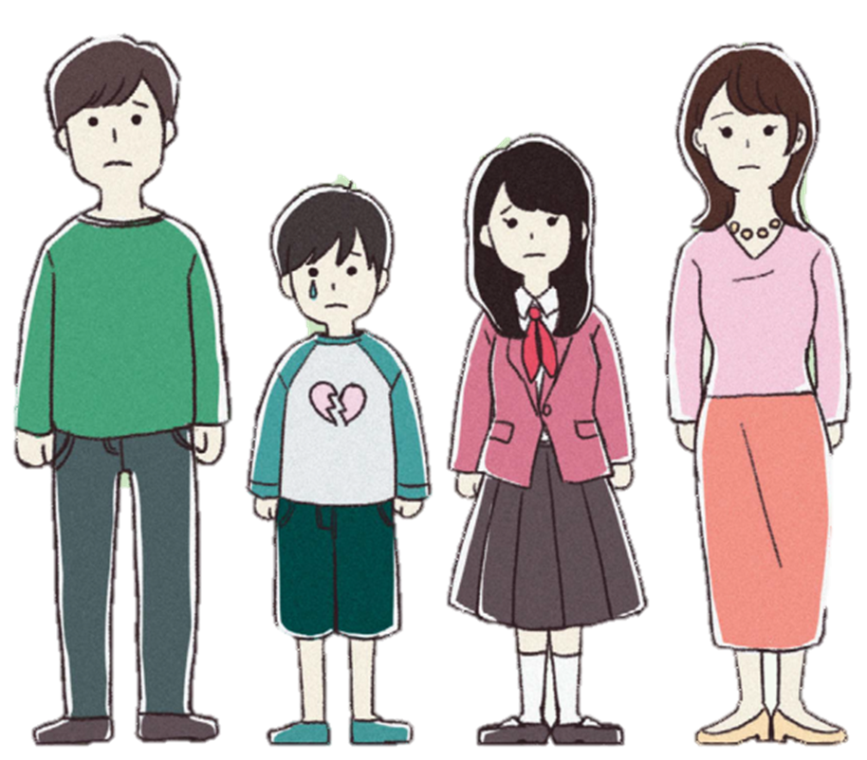
【英語版】
Are you and the people around you suffering from
DomesticViolence
Do not suffer alone, please consult professional organization.
NISHIO-SHI BARA-NET
西尾市／ばらネット

Slide 2
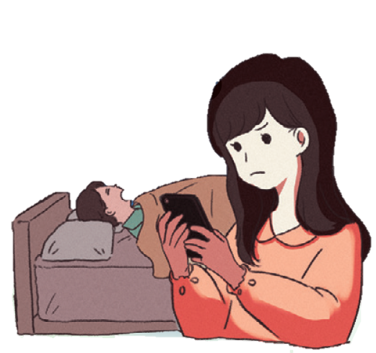
What is DV (Domestic Violence) ?
Domestic violence is the violence of someone you have a close relationship with, such as your spouse or lover. Violent person tries to control his/her partner through various kinds of "violence".
Is there anyone who displays this kind of "violence"?
Physical violence
● Beating ● Pulling hair ● Throwing objects
● Kicking ● Strangling
Mental violence
● Yelling loudly ● Not listening
● Frightening ● Making fool of yourself
Social violence (social isolation)
● Not allowing to meet relatives and friends
● Viewing smartphones and SNS without permission
Sexual violence
● Forcing sexual activity
● Not cooperating with contraception
Money violence
● Not paying living expenses ● Not allowing to work
● Spending your savings without permission
Violence using children
● Violence in front of children
● Indoctrinating children with bad words
● Attempting to take away children
There are men suffering from DV as well !
Approximately 1 in 4 people suffers from DV from his/her partner. Not only women, but also men may suffer from DV.
※Cabinet Office "Survey Report on Violence Between Men and Women" (2017)

Slide 3
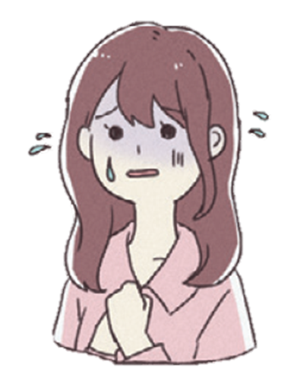
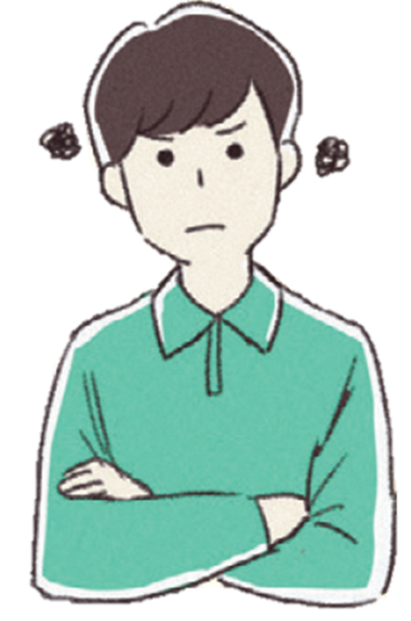
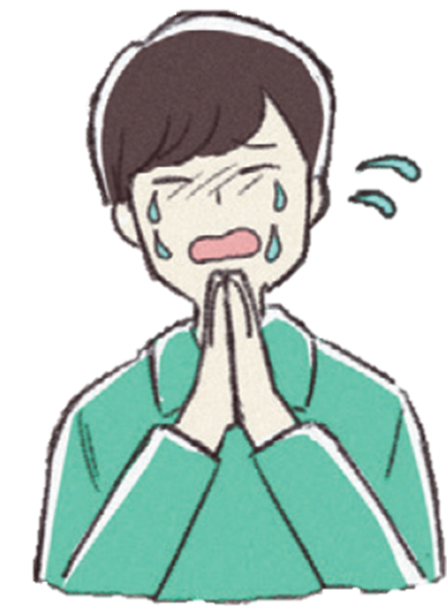
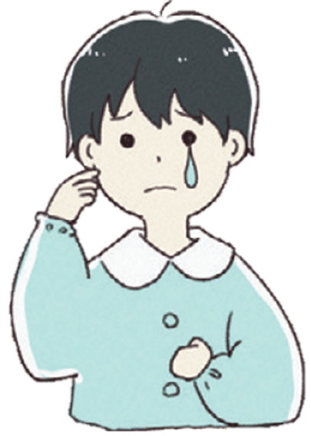
If you have been facing DV for a long time, it will be difficult to escape.
If you have been facing DV for a long time, even if you have been suffering from violent behavior, it will be more difficult for you to run away as your partner would be kinder afterwards, thinking "DV may stop...".
Cycle of violence
(American psychologist Lenore E. Walker)
Period of mental strain
Aggressor
・Irritated
・Little things make him/her
sullen
Victim
・Worried about the mood of
your partner
・Trying to do something to
prevent your partner from
arousing the rage
Time of opening up
Time of outburst
Aggressor
・Repent and apologize
・Promising to never display
violence again
Victim
・Not escaping as you are
hoping that your partner
will change
Aggressor
・Displaying violence
Victim
・Have a fear and lethargy
・ Being patient and trying
to do as your partner says
(being controlled)
DV hurts mental health of children
When children see or hear DV from their mother or father, it is
child abuse (mental abuse). Even if the child is not directly displayed
to violence, it is easy for him/her to misunderstand that the bad relationship between father and mother is "because I am a bad child" or "because I was born".
You do not have to bear DV.
DV has impact on children mental and physical health
● Running away to a fantasy world ● Become thinking that “weakness” is
● Rage something bad
● Always feeling anxious and not ● Trying to solve problems using violence
in safe ● Bedwetting
● Can not trust to others ● Can not sleep
● Self-esteem is lower ● Can not eat

Slide 4
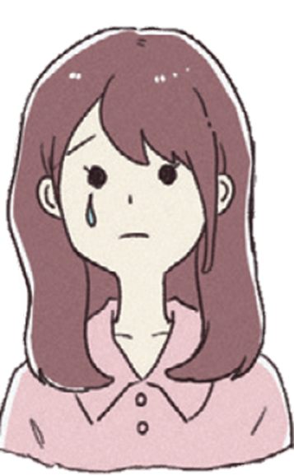
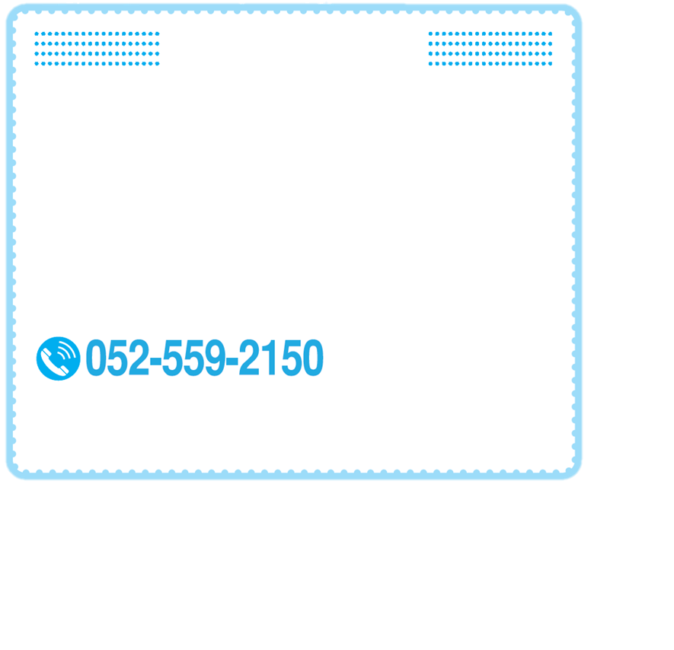
If you have been suffering from DV
Do not suffer alone, consult it with someone.
Are you worried alone, such as “If only I could bear...”,
“Would it be better to consult it with someone?”, “I try
to not it be noticed by children...”
Both DV and child abuse are very difficult issues to be solved
only by yourself.
It needs a lot of courage to consult, but if you give it a chance you may find a solution which you could not see. There are professional counseling counters where we could think over a solution together.
Your privacy will be safe, so please relief and consult.
Foreign nationals
If you are worried about your status of residence (the status with permission to live in Japan)
and your husband (or wife) does not help you change your period of stay or status of residence, or if you would like to live with a child born to a Japanese, please call the Immigration Bureau (Immigration).
Immigration Bureau telephone number
Nagoya Regional Immigration Bureau
From Monday to Friday
9:00 ~ 16:00
(Saturday and Sunday, year-end and New Year holidays are closed)
Things you should prepare in case of emergency
□ Money, passbook and cash card
□ Health insurance card (copy is fine)
□ Seal (registered seal, seal registration
certificate, bank seal, etc.)
□ House key
□ Daily medicine
□ Important things for you
□ Identification cards, such as maternal
and child handbook, pension
handbook, driving license, residence
card, passport, etc.
□ Documents that can prove violence,
such as photographs of injuries,
hospital medical record, etc.
□ Important things for your child (school
bag)

Slide 5
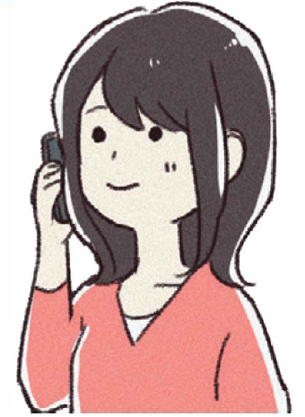
Professional counseling organization
If you are suffering from DV, please do not bear it alone and consult it with us.
Consultation is free and discreet.
※A separate telephone call charge may be applied for use.
NISHIO-SHI KATEI JIDO SHIEN KA
（telephone /interview）
0563-56-3133
Nishio City, Yorizumi-cho, Shimoda 22
From Monday to Friday（holidays, and year-end and New Year holidays are closed）
8:30 ~17:15
AICHI-KEN JYOSEI SODAN CENTER
（telephone /counter）
for woman
052-962-2527
Nagoya City, Higashi-ku, Kamitatesugi-cho 1
【Telephone】
Holidays and some Mondays and New Year holidays are closed
From Monday to Friday/ 9:00 ~ 21:00
Saturday and Sunday / 9:00 ~ 16:00
【Counter】
Please make a reservation by phone
（holidays, and year-end and New Year holidays are closed）
From Tuesday to Sunday / 9:00 ~ 17:00
（Wednesday 9h às 20h30）
AICHI-KEN
DANSEI DV HIGAISHA HOT LINE (telephone)
for man
080-1555-3055
Saturday 13:00 ~ 16:00
(every 5th Saturday and holidays, and year-end and New Year holidays are closed）
DV SODAN NAVI
080-1555-3055
Telephone calls are automatically forwarded to the nearest counseling organization from provided details such as the place of origin, etc. You can consult it directly afterwards.
Consultations are limited to the consultation hours of each institution.

Slide 6
If you are consulted about DV by a person from your neighborhood,
please advise him/her to consult it with counseling organization.
※In case of emergency, please call the police ( 110)
Step 1.
Listen carefully to the victim’s story
When someone talks to you, always answer "You're not a bad person" or "Thank you for talking to me." Never blame the person with words such as "Why don't you run away?" or "Why didn't you say it earlier?" Because those who are displayed to violence trust you and consult it with you.
Step 2.
Please advise him/her to consult it with counseling organization
DV is a very difficult problem to solve on your own. Advise the victim to consult a professional organization. If the victim wants to call the organization, but he/she is not able to do so, please call instead of him/her.
Step 3.
Keep the secret
It is very dangerous if the victim's secret is leaked to the aggressor. Please do not tell the content of the victim's story to others. Others who hear the story can hurt the victim even more.
---------------------------------Issued ---------------------------------
NISHIO-SHI TIIKI TSUNAGARI KA / KATEIJIDO SHIENKA /
SHIMIN KATSUDO GROUP BARA NET

